Slide 1
DATA 300
Time Series

Slide 2
Use your imagination..
You are going to bring cake for your teammates and need to decide how many cakes to bring.. Thinking about the previous times when you brought cake:
What are the variables you could use to determine how many cakes to bring? You could create variables.
Time | # of cakes brought | # of cakes consumed
1 | 5 | 4
2 | 5 | 5
3 | 6 | 6
4 | 6 | 4
5 | 4 | 4
6 | 5 | 4
Current
Based on how many cakes were consumed in previous time periods.
an Autoregressive process (AR)
2) Based on the difference between # of cakes brought and # of cakes consumed in previous time periods, i.e., previous forecast errors.
an moving average process (MA)

Slide 3
Agenda
Preparing a time series data for modeling
Models
AR process
MA process
ARMA process
ARIMA process

Slide 4
Important characteristics to consider in time series
Step 1: by plotting out the time series data, determining the following:
Trend
Seasonality
Outliers
Long-run cycle
Is variance constant or non-constant?
Any abrupt changes?

Slide 5
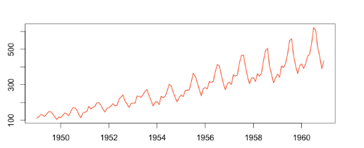
Time series plots

Slide 6
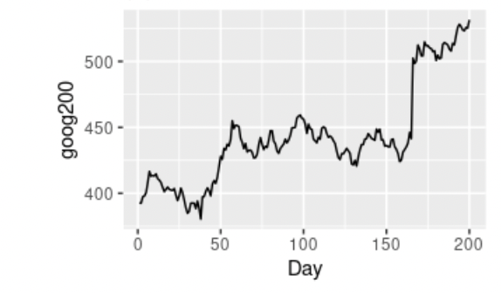
Time series plots

Slide 7
Is there a predictable pattern based on the plot?
Step 2 a): Determine if a time series is stationary or not.
Definition: A stationary time series is a time series with no predictable pattern in the long-term.

Slide 8
Is there a predictable pattern based on the plot?
Step 2 a): Determine if a time series is stationary or not.
Definition: A stationary time series is a time series with no predictable pattern in the long-term.
Is economic cycle a predictable pattern?

Slide 9
Is there a predictable pattern based on the plot?
Step 2 a): Determine if a time series is stationary or not.
Definition: A stationary time series is a time series with no predictable pattern in the long-term.
Is economic cycle a predictable pattern?
NO. Any time series with cyclic pattern is called non-predictable, because we do not know when exactly is going to happen.

Slide 10
Is there a predictable pattern based on the plot?
Step 2 b): If a process is non-stationary (has a predictable trend), convert it to a stationary process first.
Time series models are to investigate if there is any other pattern beyond trend/seasonality. In official words, we make it stationary so we can stabilize the variance.

Slide 11

Is there a predictable pattern based on the plot?
Step 2 b): If a process is non-stationary (has a predictable trend), convert it to a stationary process first.
Time series models are to investigate if there is any other pattern beyond trend/seasonality. In official words, we make it stationary so we can stabilize the variance.
Differencing is often used to make a process stationary:
While you can take the difference as many times as needed, in practice, you almost never need to take differencing more than two times (second-order differencing)

Slide 12
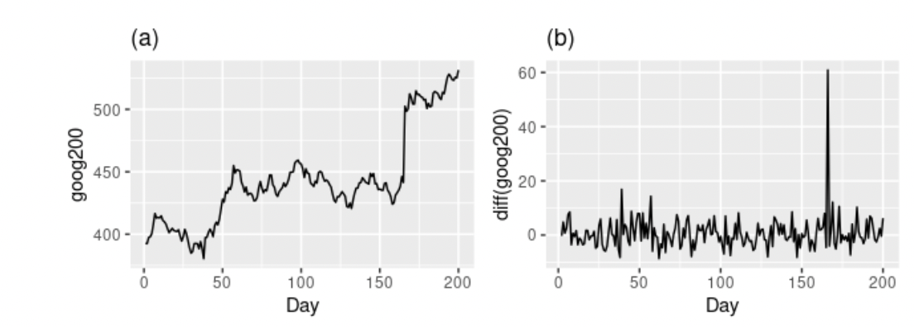
Original google stock price versus first-order differencing

Slide 13
Is there a predictable pattern based on the plot?
Step 2 b): If a process is non-stationary (has a predictable trend), convert it to a stationary process first.
Time series models are to investigate if there is any other pattern beyond trend/seasonality. In official words, we make it stationary so we can stabilize the variance.
Differencing is often used to make a process stationary:
While you can take the difference as many times as needed, in practice, you almost never need to take differencing more than two times (second-order differencing)
Not sure if the process is stationary? Use a unit root test.

Slide 14
Unit root test
H₀: the data is stationary.
H₁: the data is NOT stationary (there is a unit root).
*For the purpose of time series analysis, you actually want H₀ to be true so you can move forward.

Slide 15
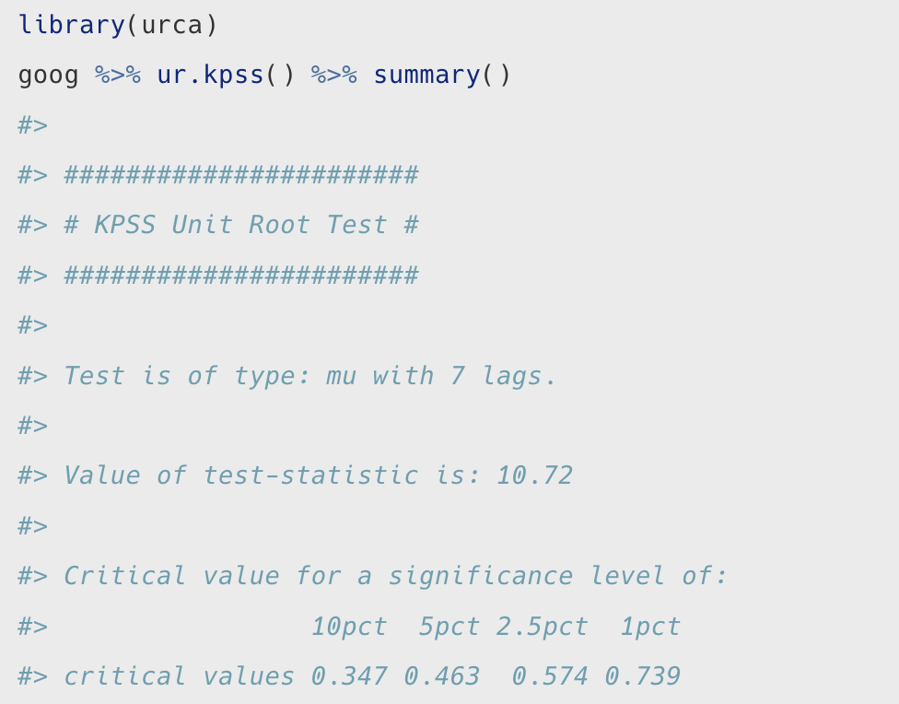
Unit root test
H₀: the data is stationary.
H₁: the data is NOT stationary (there is a unit root).
Test statistic (10.72) way higher than critical values.
Reject H₀
Take first-order differencing, and test again.

Slide 16
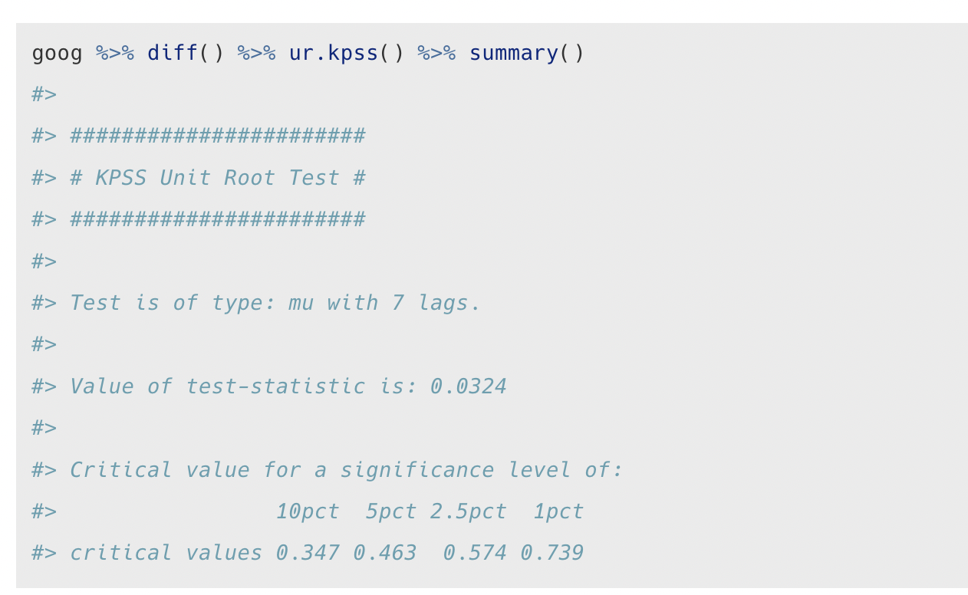
Unit root test
H₀: the data is stationary.
H₁: the data is NOT stationary (there is a unit root).
Test statistic (0.0324) smaller than critical values.
Not enough evidence to reject H₀.
The differenced series is stationary and is good enough to perform time series.

Slide 17

Bonus definitions
A white noise series is a series of observations that are independently and identically distributed with a mean of 0 and constant variance.
Example: the irreducible error term in supervised learning models are always assumed to be a white noise.
$$y=f\left(X\right)+ ∈$$

Slide 18

Bonus definitions
A white noise series is a series of observations that are independently and identically distributed with a mean of 0 and constant variance.
A random walk series is a series of observations where the current observation equals to the previous observation with a random step up and down, i.e.,
where w_{t} is a white noise.
Example: stock market

Slide 19
Agenda
Preparing a time series data for modeling
Models
AR process
MA process
ARMA process
ARIMA process

Slide 20
STOP!
At this point, the time series data should be stationary.
If the original data IS stationary, use the original data.
If it was not, use the stationary differenced data.

Slide 21
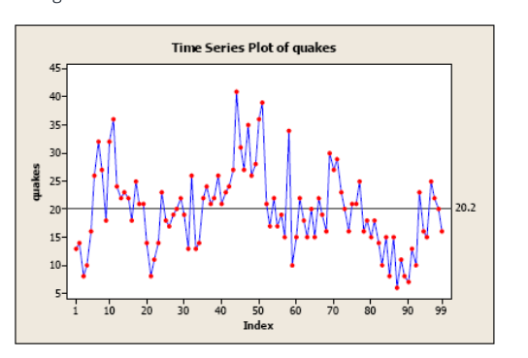
What if there is not much pattern?
Above is a plot for the number of earthquakes worldwide. What is an intuitive prediction for # of earthquakes in this upcoming year?

Slide 22

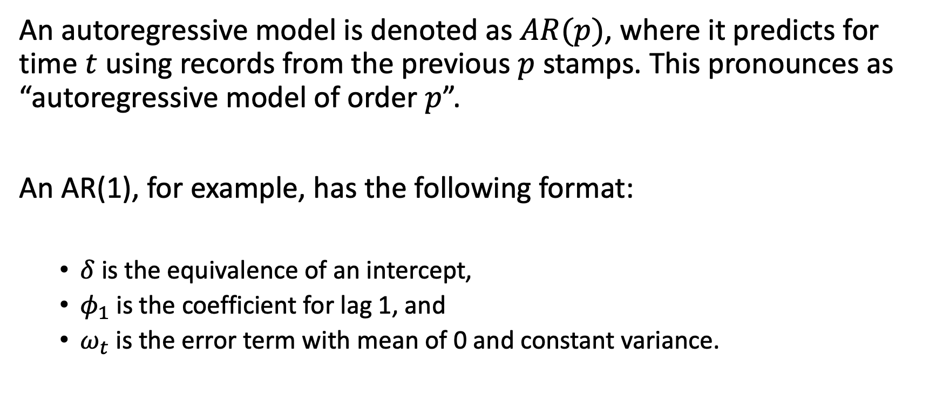
AR models (autoregressive)
An autoregressive model is denoted as $AR(p)$, where it predicts for time $t$ using records from the previous $p$ stamps. This pronounces as “autoregressive model of order $p$”.
An AR(1), for example, has the following format:
$δ$ is the equivalence of an intercept,
$φ_{1}$ is the coefficient for lag 1, and
$ω_{t}$ is the error term with mean of 0 and constant variance.

Slide 23
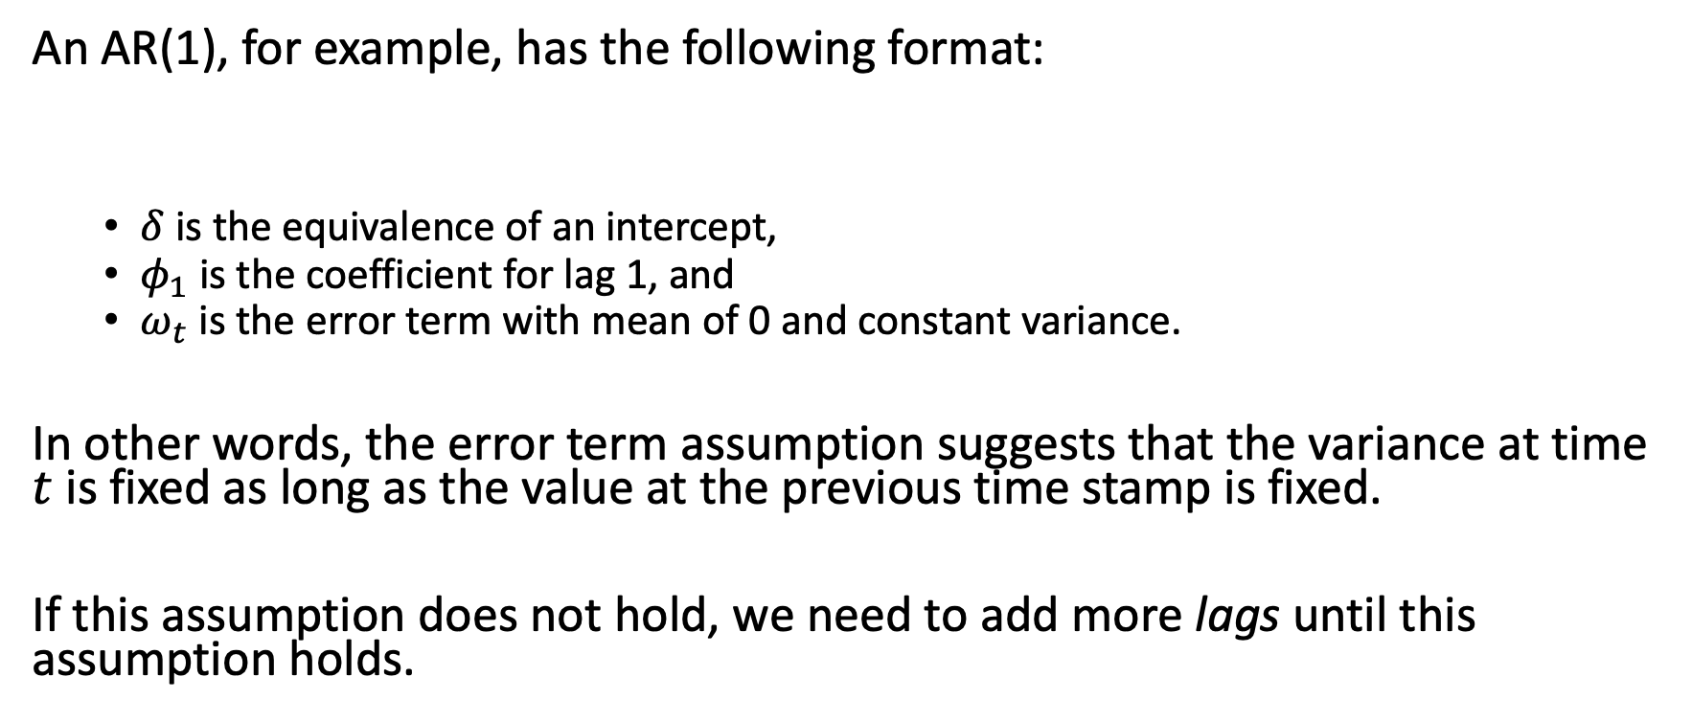
AR models (autoregressive)
An AR(1), for example, has the following format:
$δ$ is the equivalence of an intercept,
$φ_{1}$ is the coefficient for lag 1, and
$ω_{t}$ is the error term with mean of 0 and constant variance.
In other words, the error term assumption suggests that the variance at time $t$ is fixed as long as the value at the previous time stamp is fixed.
If this assumption does not hold, we need to add more lags until this assumption holds.

Slide 24

How to decide the number of lags?
An autocorrelation function (ACF) for a time series is defined as
$$Corr\left(x_{t},x_{t−k}\right)$$
In other words, if there is a strong correlation between time $x_{t}$ and $x_{t−k}$, then $x_{t−k}$ should be included in the AR model.

Slide 25
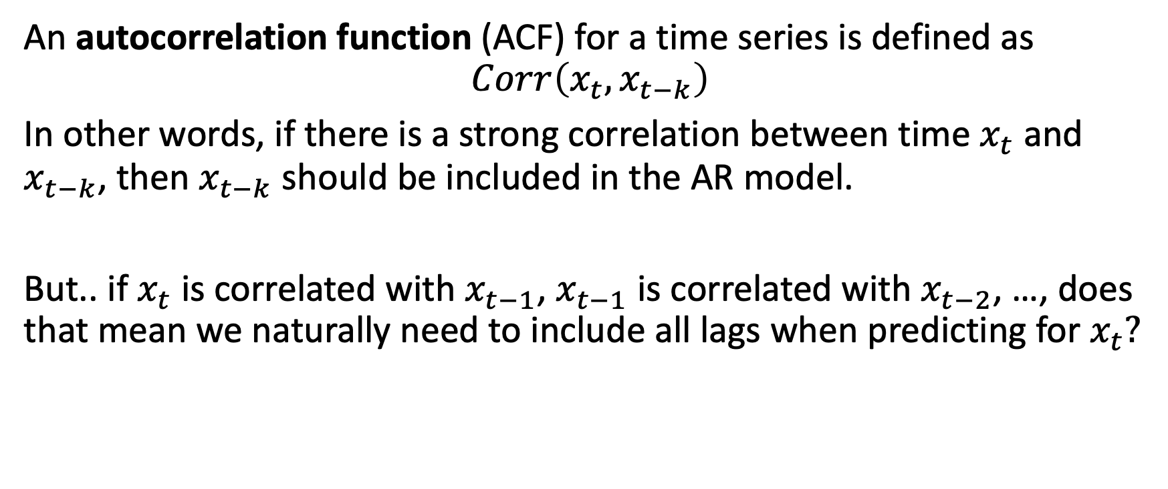
How to decide the number of lags?
An autocorrelation function (ACF) for a time series is defined as
$$Corr\left(x_{t},x_{t−k}\right)$$
In other words, if there is a strong correlation between time $x_{t}$ and $x_{t−k}$, then $x_{t−k}$ should be included in the AR model.
But.. if $x_{t}$ is correlated with $x_{t−1}$, $x_{t−1}$ is correlated with $x_{t−2}$, …, does that mean we naturally need to include all lags when predicting for $x_{t}?$

Slide 26
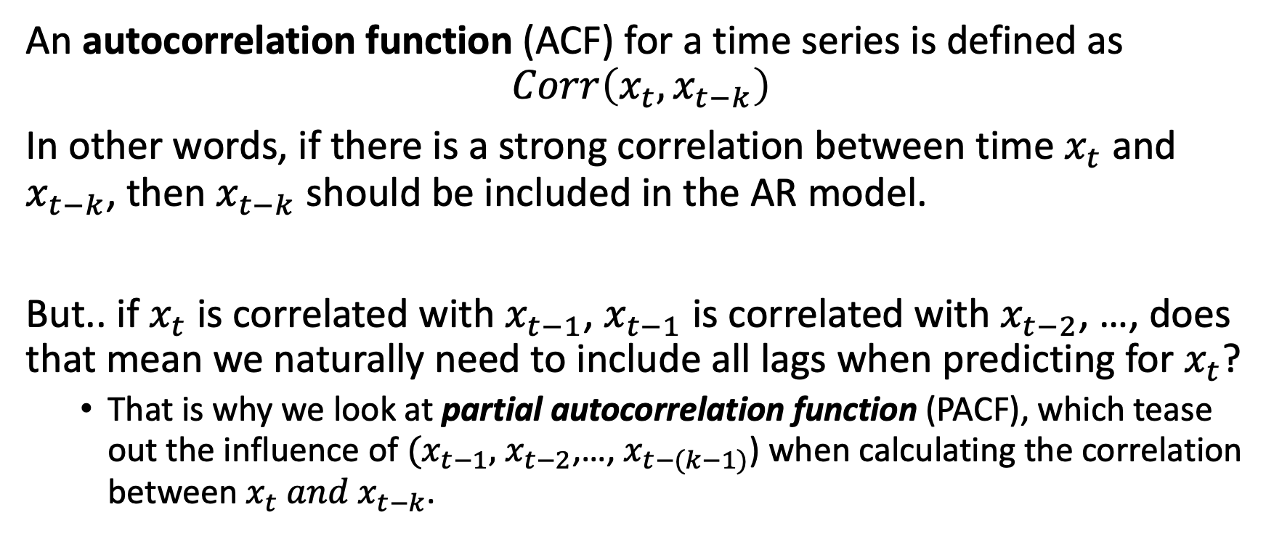
How to decide the number of lags?
An autocorrelation function (ACF) for a time series is defined as
$$Corr\left(x_{t},x_{t−k}\right)$$
In other words, if there is a strong correlation between time $x_{t}$ and $x_{t−k}$, then $x_{t−k}$ should be included in the AR model.
But.. if $x_{t}$ is correlated with $x_{t−1}$, $x_{t−1}$ is correlated with $x_{t−2}$, …, does that mean we naturally need to include all lags when predicting for $x_{t}$?
That is why we look at partial autocorrelation function (PACF), which tease out the influence of $(x_{t−1},$ $x_{t−2}$,…, $x_{t−(k−1)}$) when calculating the correlation between $x_{t} and x_{t−k}$.

Slide 27
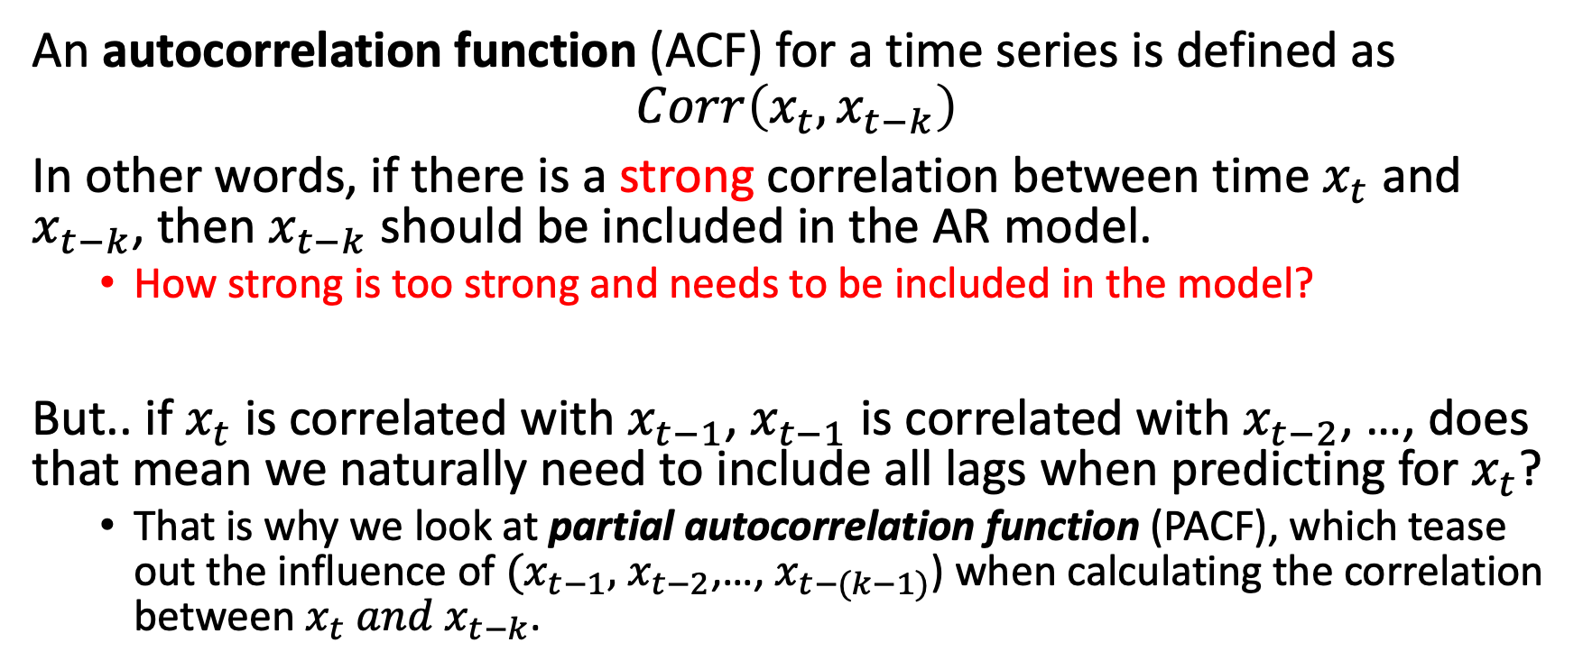
How to decide the number of lags?
An autocorrelation function (ACF) for a time series is defined as
$$Corr\left(x_{t},x_{t−k}\right)$$
In other words, if there is a strong correlation between time $x_{t}$ and $x_{t−k}$, then $x_{t−k}$ should be included in the AR model.
How strong is too strong and needs to be included in the model?
But.. if $x_{t}$ is correlated with $x_{t−1}$, $x_{t−1}$ is correlated with $x_{t−2}$, …, does that mean we naturally need to include all lags when predicting for $x_{t}$?
That is why we look at partial autocorrelation function (PACF), which tease out the influence of $(x_{t−1},$ $x_{t−2}$,…, $x_{t−(k−1)}$) when calculating the correlation between $x_{t} and x_{t−k}$.

Slide 28
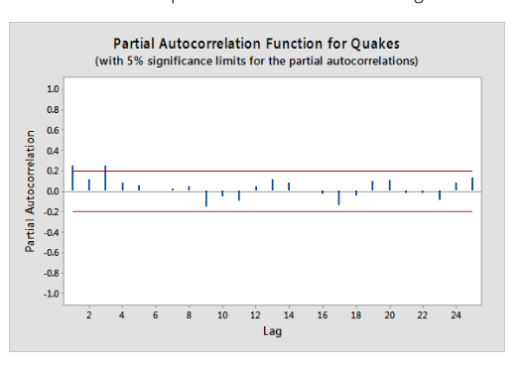
PACF plot
The two red lines stand for statistically significant, in other words, lag $k$is strongly correlated if it went outside of the red line. So the AR model needs to be..

Slide 29
PACF plot
The two red lines stand for statistically significant, in other words, lag $k$is strongly correlated if it went outside of the red line. So the AR model needs to be..
$x_{t}=δ+φ_{1}x_{t−1}+φ_{2}x_{t−2}$+ $φ_{3}x_{t−3}+ ω_{t}$

Slide 30
Agenda
AR process
MA process
ARMA process
ARIMA process

Slide 31
Use your imagination..
You are going to bring cake for your teammates and need to decide how many cakes to bring.. Thinking about the previous times when you brought cake:
What are the variables you could use to determine how many cakes to bring? You could create variables.
Time | # of cakes brought | # of cakes consumed
1 | 5 | 4
2 | 5 | 5
3 | 6 | 6
4 | 6 | 4
5 | 4 | 4
6 | 5 | 4
Current
Based on how many cakes were consumed in previous time periods.
an Autoregressive process (AR)
2) Based on the difference between # of cakes brought and # of cakes consumed in previous time periods.
an moving average process (MA)

Slide 32

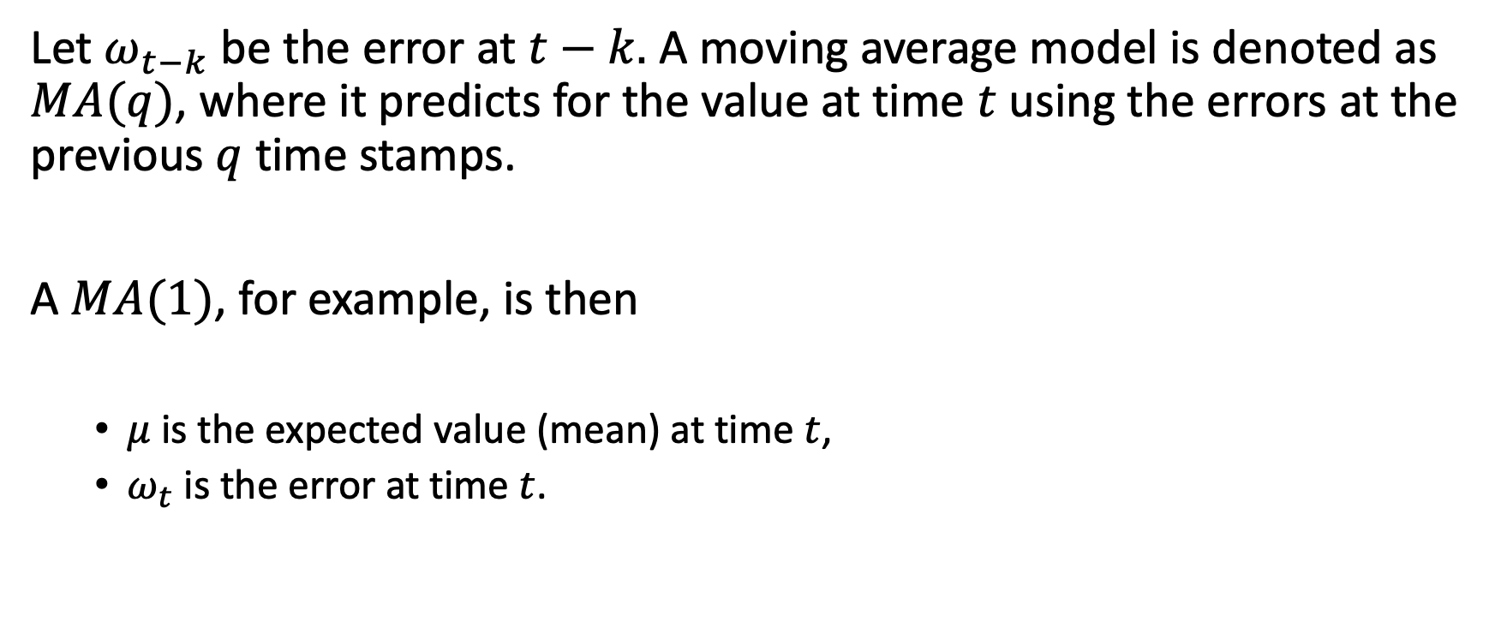
MA process
Let $ω_{t−k}$ be the error at $t−k.$ A moving average model is denoted as $MA(q)$, where it predicts for the value at time $t$ using the errors at the previous $q$time stamps.
A $MA(1)$, for example, is then
$μ$ is the expected value (mean) at time $t$,
$ω_{t}$ is the error at time $t$.

Slide 33
The two ways to identify the number of lags..
An autocorrelation function (ACF) for a time series is defined as
$$Corr\left(x_{t},x_{t−k}\right)$$
In other words, if there is a strong correlation between time $x_{t}$ and $x_{t−k}$, then $x_{t−k}$ should be included in the AR model.
But.. if $x_{t}$ is correlated with $x_{t−1}$, $x_{t−1}$ is correlated with $x_{t−2}$, …, does that mean we naturally need to include all lags when predicting for $x_{t}$?
That is why we look at partial autocorrelation function (PACF), which tease out the influence of $(x_{t−1},$ $x_{t−2}$,…, $x_{t−(k−1)}$) when calculating the correlation between $x_{t} and x_{t−k}$.

Slide 34
How to decide how many lags to include for a MA model?
Conclusion: We use the PACF plot for AR model, but the ACF plot for MA model.

Slide 35
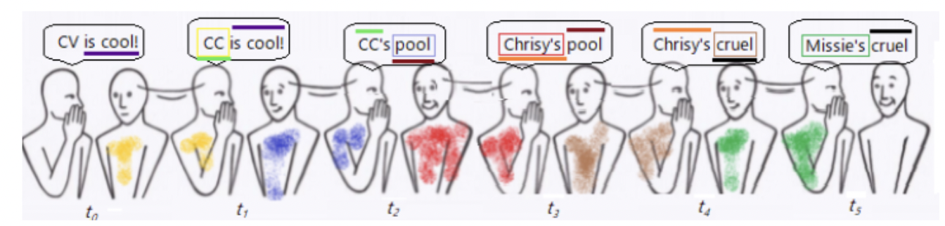
How to decide how many lags to include for a MA model?
Conclusion: We use the PACF plot for AR model, but the ACF plot for MA model.
Intuition: Think about the Chinese whispers game (https://en.wikipedia.org/wiki/Chinese_whispers).

Slide 36
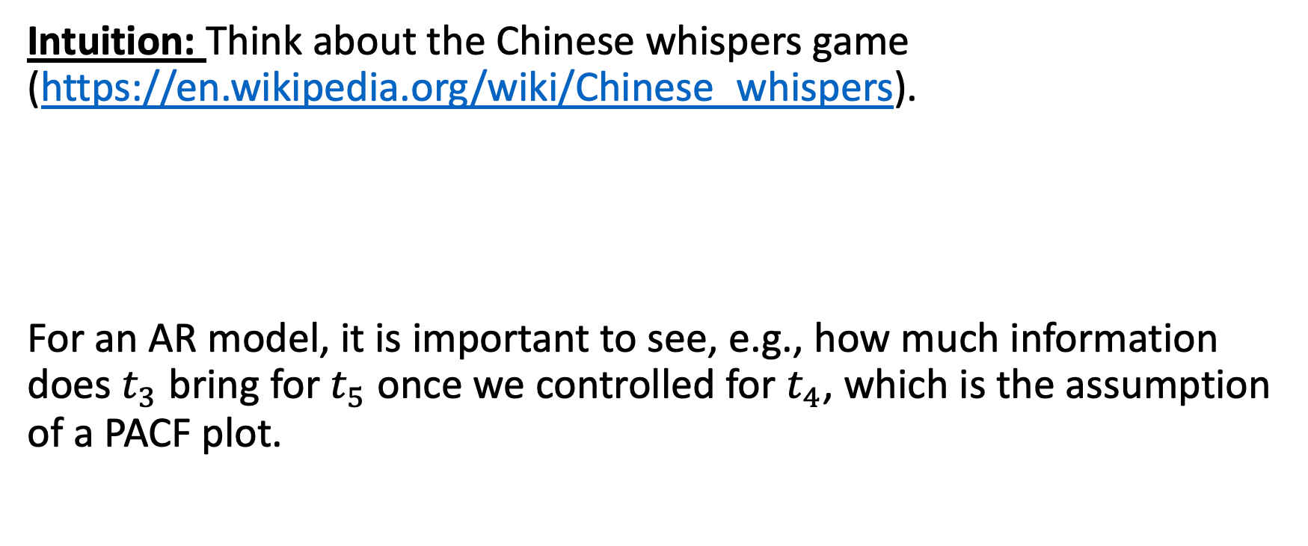
How to decide how many lags to include for a MA model?
Intuition: Think about the Chinese whispers game (https://en.wikipedia.org/wiki/Chinese_whispers).
For an AR model, it is important to see, e.g., how much information does $t_{3}$ bring for $t_{5}$ once we controlled for $t_{4}$, which is the assumption of a PACF plot.

Slide 37

How to decide how many lags to include for a MA model?
Intuition: Think about the Chinese whispers game (https://en.wikipedia.org/wiki/Chinese_whispers).
For a MA model, the error at any $t_{k}$ is naturally a mix of errors from all the previous terms until time $k$. Therefore, there is no need to control for anything, which is the assumption of ACF.

Slide 38
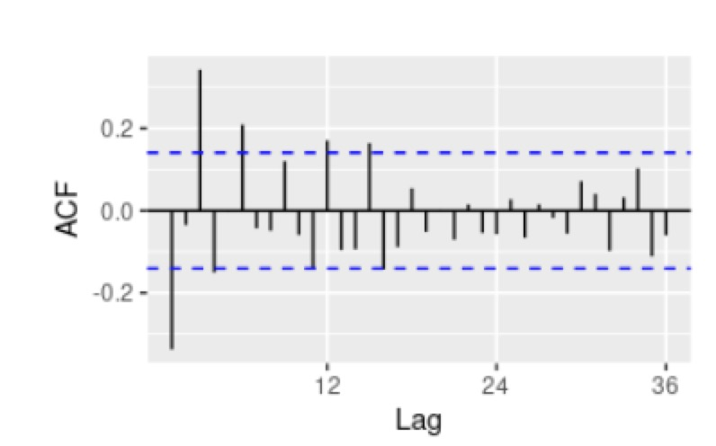
How to decide how many lags to include for a MA model?
Conclusion: We use the PACF plot for AR model, but the ACF plot for MA model.
We read it the exact same way as a PACF. In this plot, for example, MA(3) would be a good start.

Slide 39
Use your imagination..
You are going to bring cake for your teammates and need to decide how many cakes to bring.. Thinking about the previous times when you brought cake:
What are the variables you could use to determine how many cakes to bring? You could create variables.
Time | # of cakes brought | # of cakes consumed
1 | 5 | 4
2 | 5 | 5
3 | 6 | 6
4 | 6 | 4
5 | 4 | 4
6 | 5 | 4
Current
Based on how many cakes were consumed in previous time periods.
an Autoregressive process (AR)
2) Based on the difference between # of cakes brought and # of cakes consumed in previous time periods, i.e., previous forecast errors.
an moving average process (MA)

Slide 40

Combining MA and AR
A ARMA model uses a combination of past observations and past errors for prediction.

Slide 41
Combining MA and AR
A ARMA model uses a combination of past observations and past errors for prediction.
It is denoted as ARMA(p, q), where p is the AR component and stands for the number of past observations, and q is the MA component and stands for the number of past residuals.

Slide 42
Summary
Step 1: plot the time series.
Step 2: Determine if the time series is stationary by looking for patterns. Stationary = no predictable pattern.
Step 2 b): if there is any pattern, use differencing until the differenced series is stationary.
Step 3: Use the stationary time series to build a(n) AR/MA/ARMA model, depending on the need.
Use PACF to identify the number of lags for an AR model.
Use ACF to identify number of lags for a MA model.

Slide 43
Agenda
Preparing a time series data for modeling
Models
AR process
MA process
ARMA process
ARIMA process

Slide 44
ARIMA model
An ARIMA model stands for Autoregressive Integrated Moving Average.

Slide 45
ARIMA model
An ARIMA model stands for Autoregressive Integrated Moving Average.
The time series does not need to be stationary for an ARIMA model. An ARIMA model is denoted as ARIMA(p, d, q), where d is the number of times for differencing.
In other words, ARIMA converts a potentially non-stationary process to a stationary process through parameter d.

Slide 46
Determining p, d, q in ARIMA (or p, q in ARMA)
Why it is hard to use ACF/PACF plots to determine p and q at the same time?

Slide 47
Determining p, d, q in ARIMA (or p, q in ARMA)
Why it is hard to use ACF/PACF plots to determine p and q at the same time?
After accounting for past observations (AR model), the influence of past errors might change.
In other words, p and q are dependent.

Slide 48
Determining p, d, q in ARIMA (or p, q in ARMA)
We will discuss more when we get to variable selection, but two important measures: AIC and BIC.
We generally want a model with smaller AIC and BIC.

Slide 49
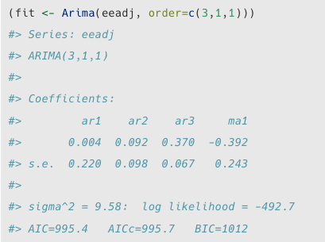
Determining p, d, q in ARIMA (or p, q in ARMA)
We will discuss more when we get to variable selection, but two important measures: AIC and BIC.
We generally want a model with smaller AIC and BIC.

